Slide 1
Multi-Agent Collision Avoidance
via Hamilton-Jacobi reachability and Mixed Integer Programming

Slide 2




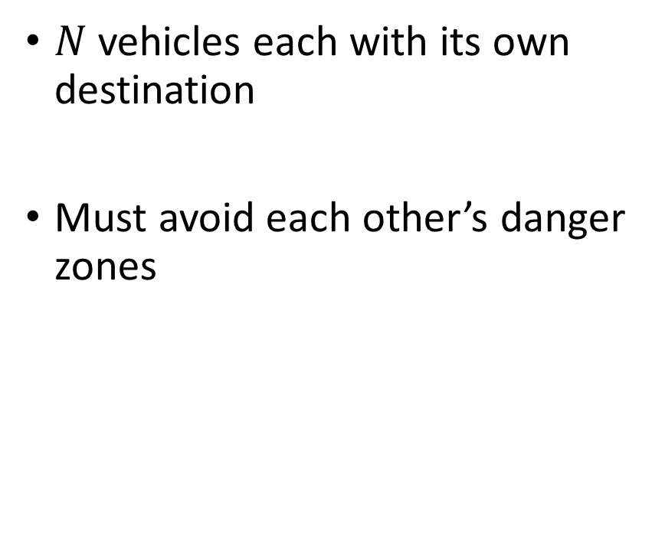
Problem set up
$N$ vehicles each with its own destination
Must avoid each other’s danger zones
Targets
Vehicle
Danger zone

Slide 3
Background
Hamilton-Jacobi reachability
Computes reachable set – the set of states from which collision could occur
Indicates safety level between any two vehicles
Provides safety controller that guarantees pair wise collision avoidance
Intractable for multiple vehicles
Mixed integer programming
Takes safety values and joint configuration into account
Provides avoidance logic in multi-vehicle systems
Produces joint collision avoidance maneuver for multiple vehicles

Slide 4
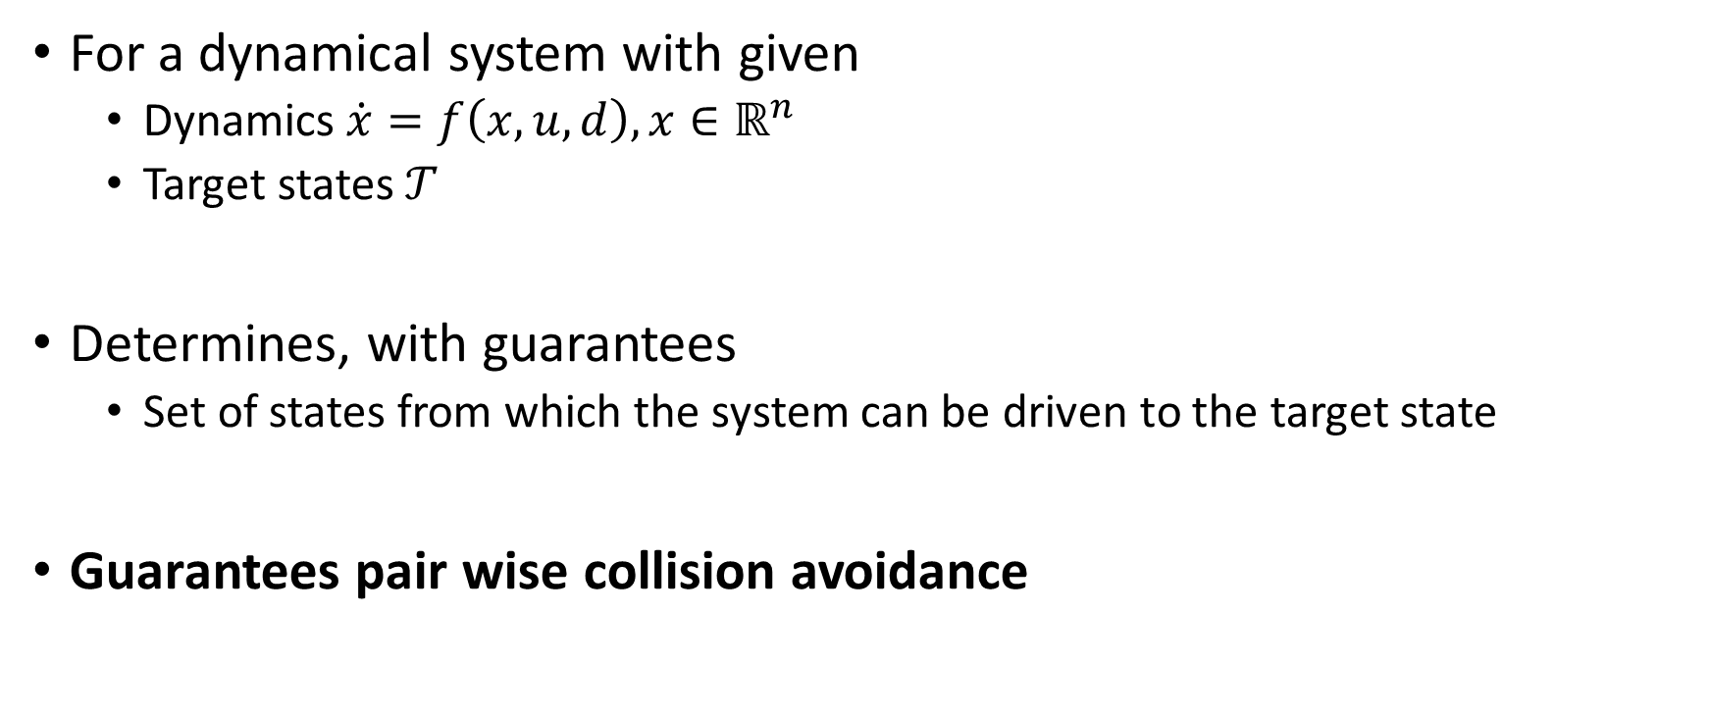
HJ Reachability for Collision Avoidance
For a dynamical system with given
Dynamics $\dot{x}=f\left(x,u,d\right),x∈ℝ^{n}$
Target states $𝒯$
Determines, with guarantees
Set of states from which the system can be driven to the target state
Guarantees pair wise collision avoidance
Reachable set
Target set

Slide 5
Mixed Integer Program for Collision Avoidance
Optimization intuition:
Cooperatively resolve as many pair wise conflicts as possible
Subject to
Efficient use of control authority
At most one vehicle in each pair wise conflict performs avoidance maneuver
Avoid multiple vehicles at once where possible
Limited avoidance capabilities of each vehicle
Allows non-conflicted vehicles to “help” with joint avoidance
Dictates cooperative avoidance logic between all vehicle pairs

Slide 6
Three-vehicle safety guarantee
Joint avoidance maneuvers guarantee collision avoidance for three vehicles
Previously not possible using only HJ reachability
[3-vehicle VIDEO HERE]

Slide 7
Multi-vehicle performance
[NAÏVE APPROACH VIDEO]
[NEW APPROACH VIDEO]

Slide 8
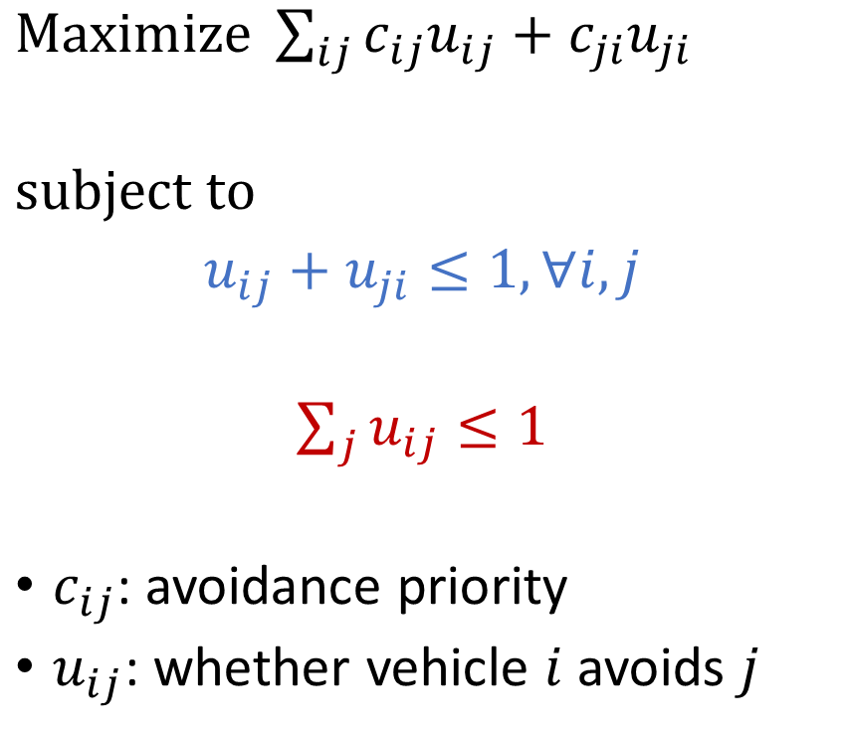
Details of basic optimzation
$Maximize \sum_{ij}{c_{ij}u_{ij}+c_{ji}u_{ji}}$
$subject to$
$u_{ij}+u_{ji}≤1, ∀i,j$
$\sum_{j}{u_{ij}}≤1$
$c_{ij}$: avoidance priority
$u_{ij}$: whether vehicle $i$ avoids $j$
Maximize number of resolved conflicts
Efficient use of control authority
Avoidance limitations

